Slide 1
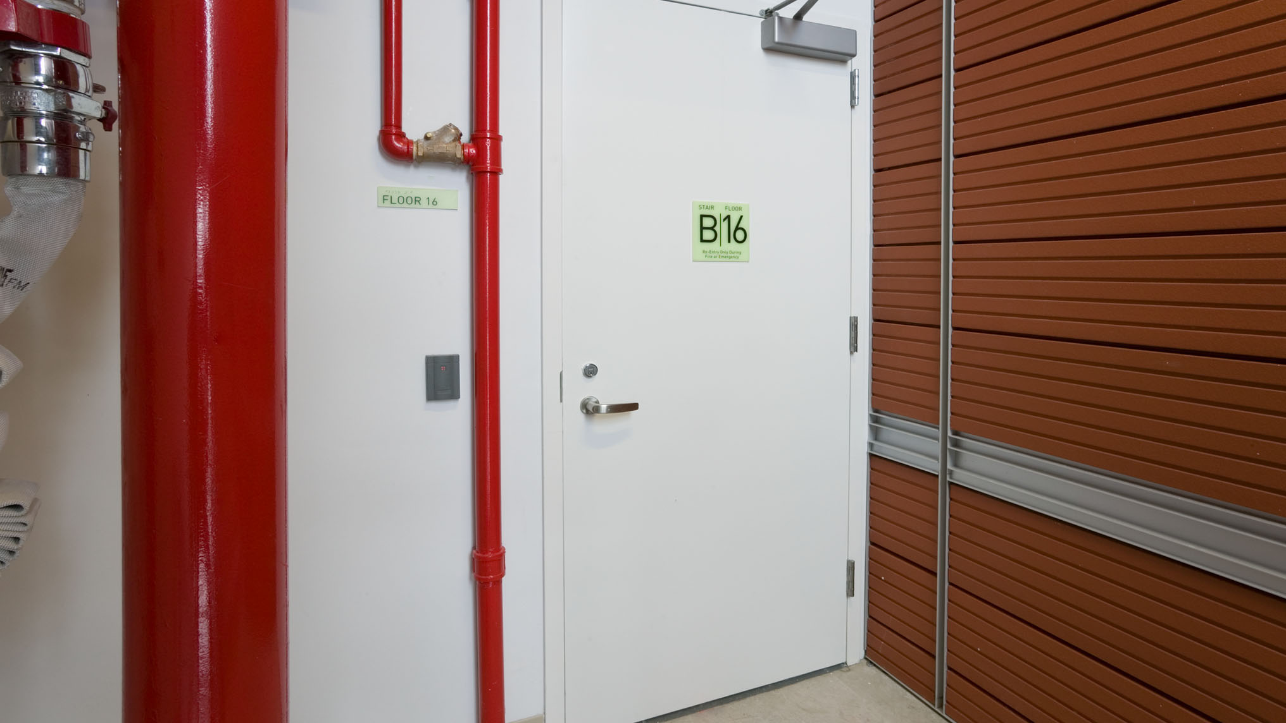














Fire-Rated Door Assemblies: Compliant Designs
Updated 2024
AIA Provider #G389 | Course # SDIFIRE | 1 HSW CE hour
Steel Door Institute
www.steeldoor.org

Slide 2
Credit(s) earned on completion of this course will be reported to AIA CES for AIA members. Certificates of Completion for both AIA members and non-AIA members are available upon request.
This course is registered with AIA CES for continuing professional education. As such, it does not include content that may be deemed or construed to be an approval or endorsement by the AIA of any material of construction or any method or manner of handling, using, distributing, or dealing in any material or product.
Questions related to specific materials, methods, and services will be addressed at the conclusion of this presentation.

Slide 3
Course Description
This course provides a comprehensive look at fire-rated door assemblies with a focus on compliant designs for fire doors, frames, and hardware. Learn the fundamental requirements for fire door assemblies across various enclosures and understand how to meet these standards.
Covered are the necessary codes, requirements, and design considerations to ensure fire-rated openings are compliant. Key requirements from the International Building Code (IBC), the National Fire Protection Association (NFPA), and UL safety standards are included to provide comprehensive knowledge on fire enclosures.
Learn the anatomy of a fire door, installation, labeling, and allowable job site modifications. Also included are critical points that should be addressed in the fire door assembly inspection checklist.

Slide 4
Learning Objectives
Upon completion of this course, you will be able to:
  Describe the purpose of fire door assemblies and common locations they can be found.
1
2
  Explain common fire door design considerations including Dutch doors, louvers, and glazing.
3
  Define proper hardware requirements for various fire-rated door assemblies per NFPA 80 standards.
4
  Understand the difference between fire protection and fire resistance as it pertains to openings.
5
Identify the thirteen critical items that make up the fire assembly inspection checklist.

Slide 5
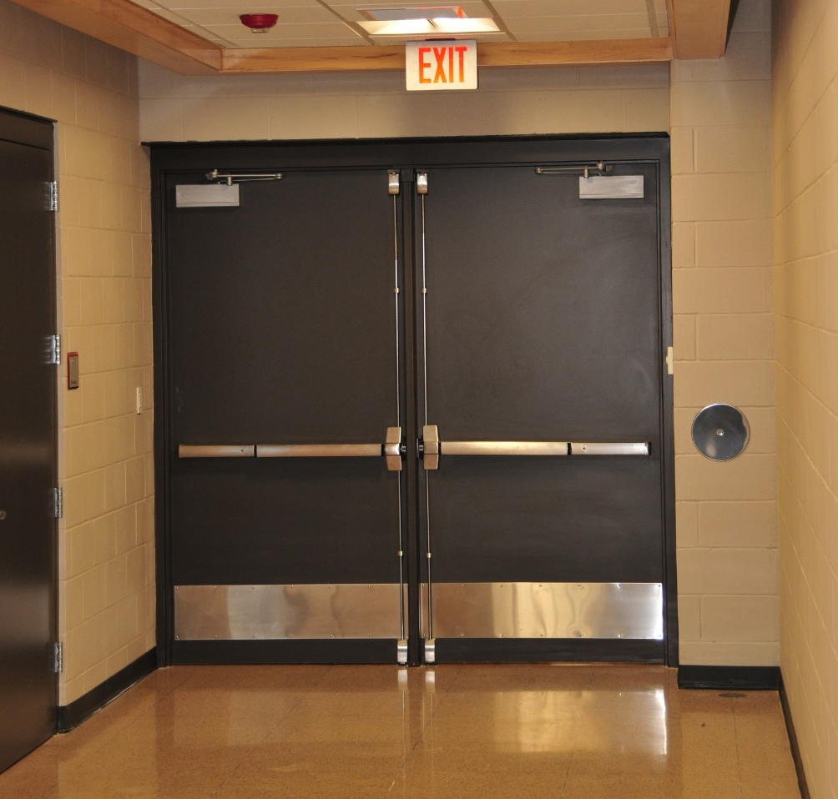
Fire Door Assemblies
What are they?
Fire door assemblies consist of a combination of the fire door, frame, hardware, and other accessories such as seals and gaskets
They are designed to work together to provide a barrier to prevent the spread of fire and smoke within a building
Fire-resistance-rated walls also help compartmentalize a building to deter the spread of smoke and flames
5

Slide 6

Fire Door Assemblies
Where are they required?
Fire door assemblies must comply with local building codes and fire safety regulations
Most US states use the International Building Code (IBC) to specify where fire door assemblies are required
Regular inspections and maintenance are crucial to ensure that they function correctly in the event of a fire, including:
  Checking for proper alignment
  Functionality of self-closing devices
  The condition of seals and gaskets
6

Slide 7
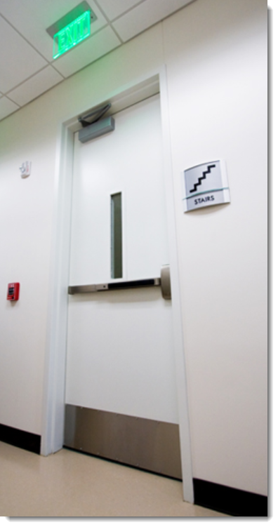
Fire Doors: Common Locations
Stairwells
Stairwell fire doors are essential for protecting escape routes in multi-story buildings, preventing the spread of fire and smoke into stairwells
They are typically equipped with self-closing and self-latching mechanisms to ensure they close and latch automatically after use allowing for the containment of smoke and fire
These doors must adhere to stringent building codes and fire safety standards, which often require specific fire protective or fire resistance ratings
7

Slide 8

Fire Doors: Common Locations
Residential Corridors
Dwelling units in a residential occupancy building (apartment, hotel, or dormitory) usually have fire-rated entry doors
Fire doors in residential corridors are designed to contain the spread of fire and smoke within specific areas of a building, providing critical protection to residents and allowing safe evacuation routes
They must comply with local building codes and fire safety regulations, which specify fire resistance ratings and installation standards
8

Slide 9
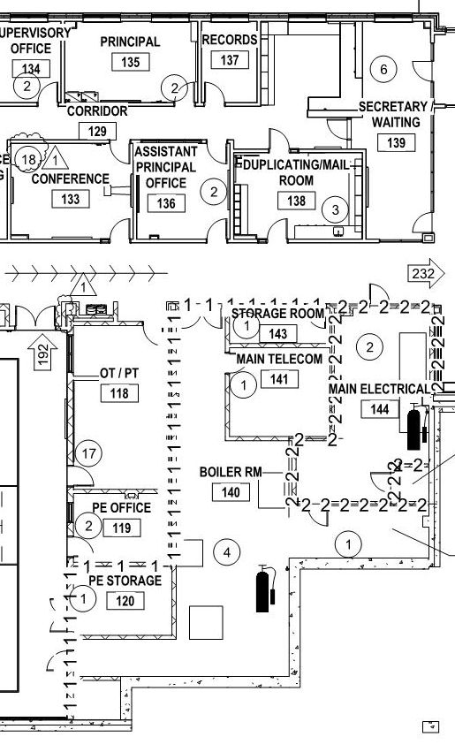
Fire Doors: Common Locations
Incidental Use Areas
Rooms with a higher risk of fire are sometimes required to have fire-resistance-rated walls and fire door assemblies
Incidental use areas may include certain electrical rooms, furnace rooms, boiler rooms, refrigerant machinery rooms, incinerator rooms, paint shops, laboratories, and large laundry rooms
The building code specifies which rooms require fire door assemblies
9

Slide 10
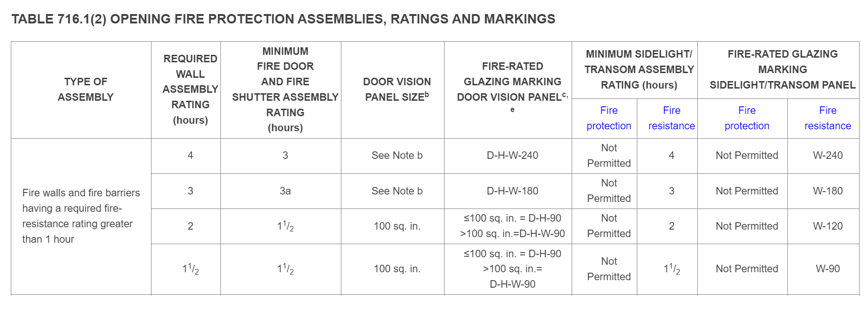
Fire Code Requirements
IBC Table 716.1(2) – Opening Fire Protection Assemblies, Ratings & Markings
This table from the International Building Code (IBC) defines the required fire-resistance rating of the wall and the opening protective:
10

Slide 11
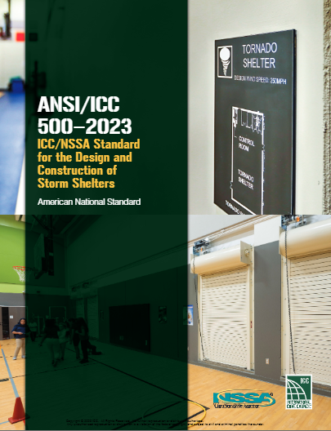
Fire Code Requirements
ANSI/ICC 500 – Standard for the Design & Construction of Storm Shelters
Community storm shelters within host buildings require a fire-resistance rating of 2 hours
Exceptions exist for this requirement including design occupancy, shelter location, and location of egress doors
Fire doors in fire barriers required solely for compliance with ICC 500 are not required to be self- or automatic-closing
11

Slide 12
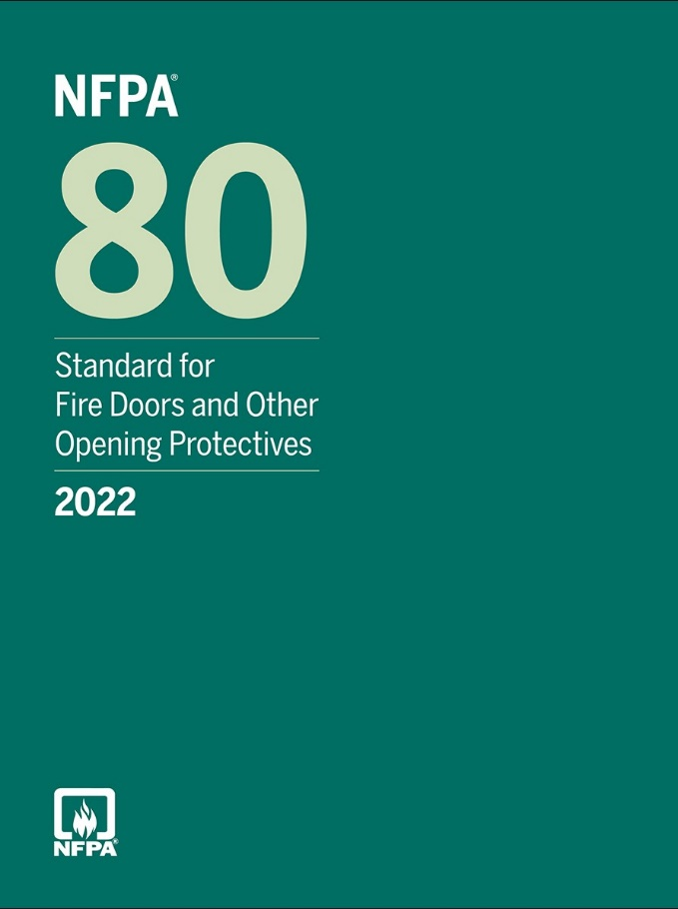
Fire Code Requirements
NFPA 80 - Standard for Fire Doors & Other Opening Protectives
NFPA 80 (National Fire Protection Association) is a comprehensive standard that governs the installation, inspection, testing, and maintenance of fire door assemblies and other protective openings.
This standard mandates regular inspections and maintenance of fire door assemblies to help ensure that fire doors remain in good working condition and can perform their critical safety functions during a fire
The standard requires that all fire door assemblies be certified and labeled by recognized testing laboratories, indicating their fire resistance rating and compliance with NFPA 80
12

Slide 13
Fire Code Requirements
Classification of Openings
NFPA 80 classifies the types of openings protected by fire doors by referencing a single letter designation which may be displayed on the label:
Class A | Openings in fire walls and in walls that divide a single building into fire areas
Class B | Openings in enclosures of vertical communications through buildings and in 2-hour rated partitions providing horizontal fire separations
Class C | Openings in walls or partitions between rooms and corridors having a fire resistance rating of 1 hour or less
Class D | Openings in exterior walls subject to severe fire exposure from outside the building
Class E | Openings in exterior walls subject to moderate or light fire exposure from outside the building
13

Slide 14
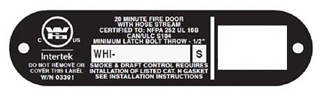
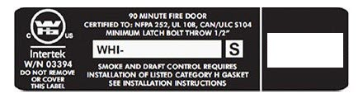
Fire Code Requirements
Classification of Openings
Fire door assemblies are also classified by the number of minutes they have been tested to withstand fire:
Note that a 20-minute rating is commonly used for smoke control doors
B-label doors used in a stair enclosure may either be classified for 60 minutes or 90 minutes depending on the rating of the enclosure
180 minutes
90 minutes
60 minutes
45 minutes
20 minutes
20 Minute Fire Door Label Example
90 Minute Fire Door Label Example
14

Slide 15
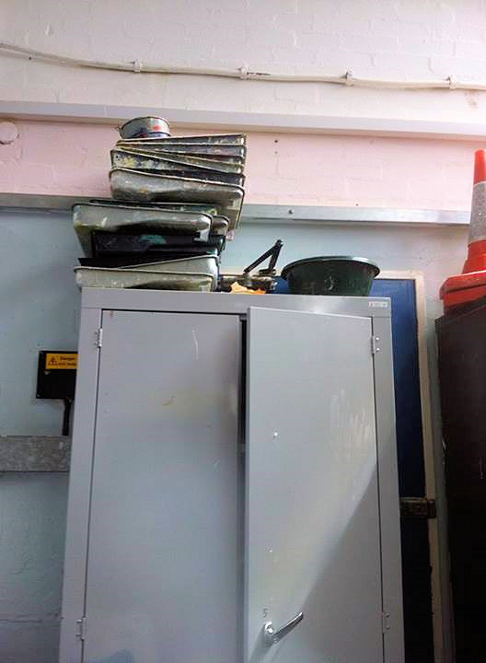
Fire Code Requirements
Classification of Openings
The fuel load adjacent to a door is typically lower than the fuel load against a wall, so the rating of a fire door assembly is usually lower than the rating of the wall
Fire doors that are no longer used should be replaced with construction equivalent to the wall rating
The photo illustrates a cabinet that has been placed in front of an unused door, increasing the fuel load
15

Slide 16
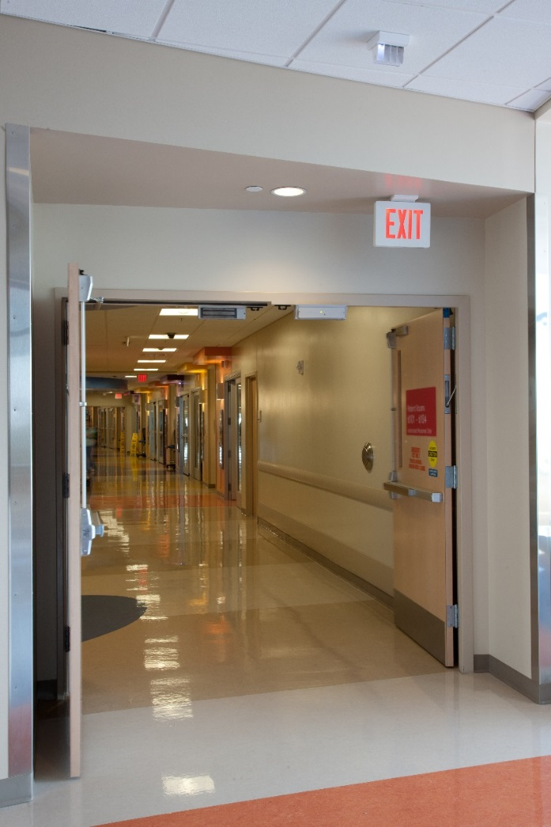
Types of Fire Door Openings
Double-Egress Doors
Double-egress fire doors are specialized door assemblies consisting of a pair of doors that swing in opposite directions
They are designed primarily for high-traffic areas where two-way pedestrian flow is necessary
These doors are ideal for busy corridors, particularly in healthcare facilities, schools, and other public buildings where quick and safe evacuation is crucial
Despite their unique swinging mechanism, double-egress fire doors maintain the same fire and smoke containment properties as standard fire doors
16

Slide 17

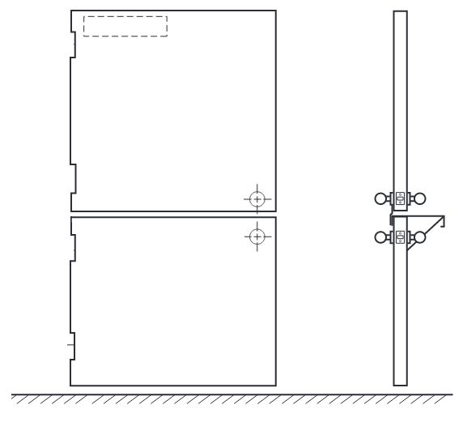


Types of Fire Door Openings
Dutch Doors
A fire-rated Dutch door, also known as a stable door or half door, is divided horizontally into two parts, allowing the top half to open independently of the bottom half
Fire-rated Dutch doors typically have:
    A door closer and electronic hold-open device on the top leaf
    An astragal between the top and bottom leaves to close bottom leaf
    An active latch bolt on each leaf
17

Slide 18


Fire Door Assemblies
Components
Component Listings: Components used as part of a fire door assembly must be specifically listed for that purpose, ensuring they meet the necessary fire safety standards and certifications
Compatibility and Certification: Components can be sourced from different manufacturers and listing agencies, provided they are compatible and each component is individually certified for use in fire door assemblies
18

Slide 19
Fire Door Assemblies
Anatomy of a Fire Door
Door Frames
Door Hinges
Electric Strikes (optional)
Door Closers or Door Operators
Fire Door Holders
Single Point Locks or Latches (Manual / Electrical) or Two or Three Point Locks (Auxiliary)
Fire Door or Glass Light Frames
Glazing Materials
Fire Exit Hardware
Gasketing & Edge Sealing Materials
Flush or Surface Bolts (Automatic / Manual / Self-Latching)
19

Slide 20
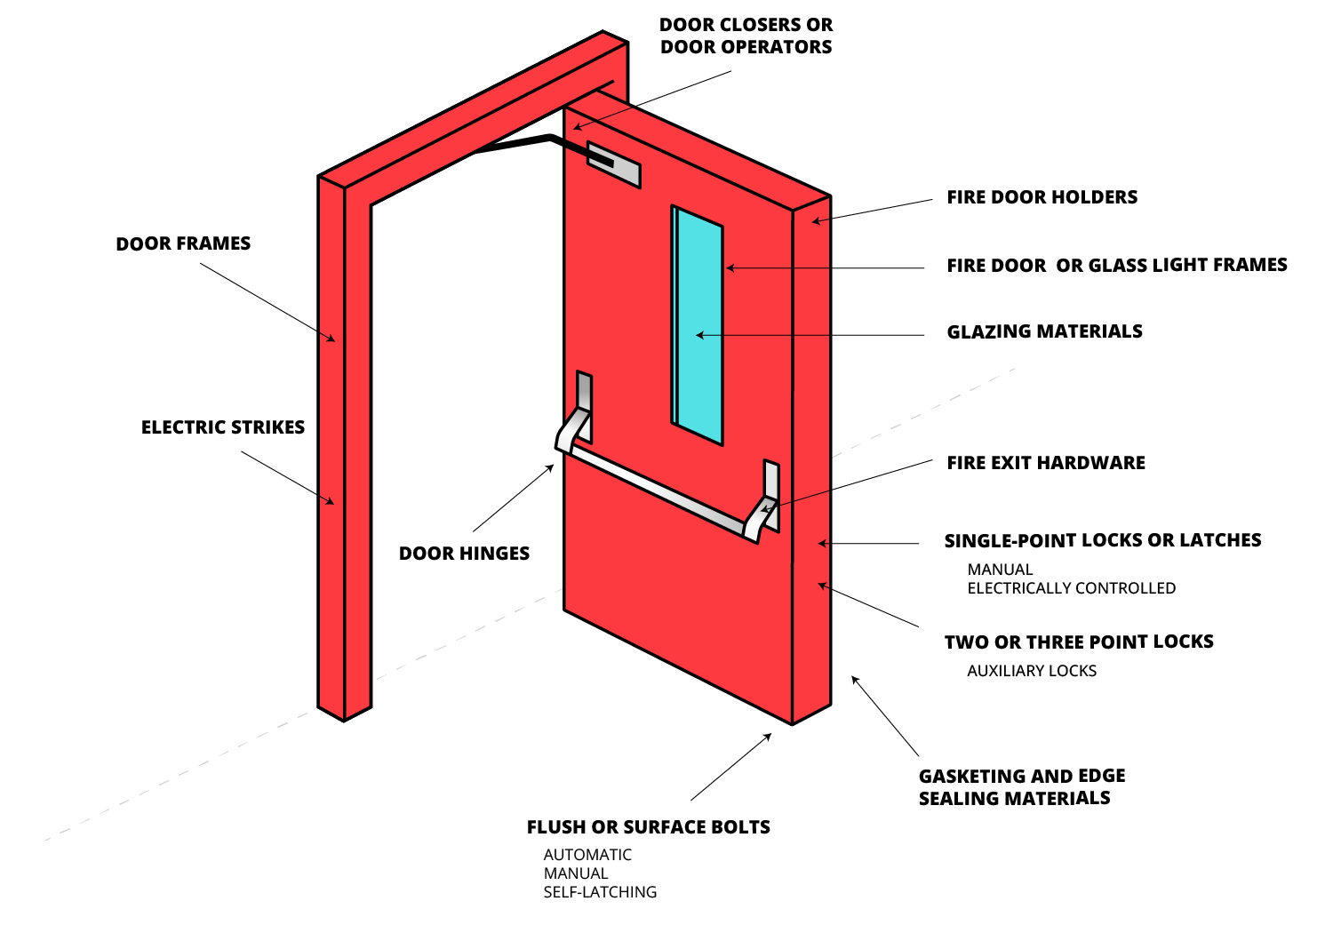
Fire Door Assemblies
Anatomy of a Fire Door
20

Slide 21
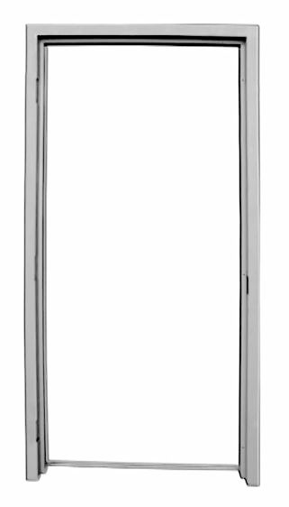
Fire Door Frames
Construction
Knock-Down Frames: Knock-down (KD) fire door frames are designed for easy assembly on-site, typically shipped in three separate pieces (jambs and head) that are bolted or screwed together
  These frames maintain their fire rating through precise alignment and secure fastening of components
Welded Frames: Welded fire door frames are fabricated as a single, continuous unit with all joints welded together
  They provide superior strength and durability, ensuring the frame remains intact and aligned under fire conditions
Transom, sidelight, and borrowed light frames are typically welded units for fire doors, but also may be field-spliced
21

Slide 22
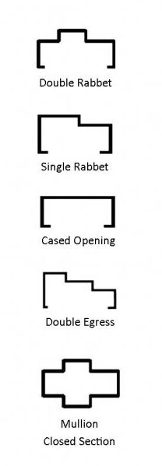
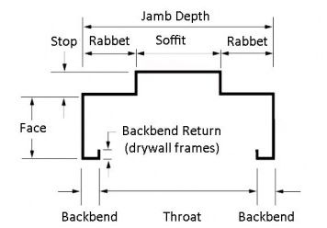
Fire Door Frames
Opening Size & Jamb Depth
Door opening sizes are limited by manufacturer’s listings and by the structural integrity and ability to function properly
Jamb depth of frame relates to wall thickness – verify availability of fire-rated configuration for custom profiles
22

Slide 23
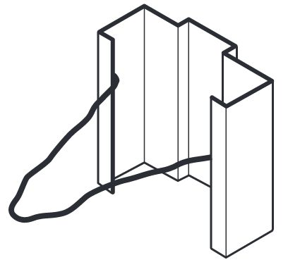
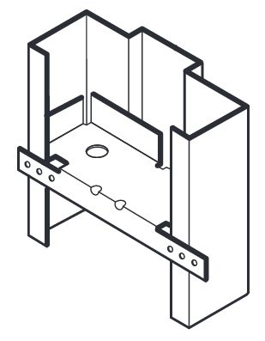
Fire Door Frames
Anchors
Anchors are critical components in the installation of fire door frames, ensuring that the frames are securely attached to the surrounding wall structure.
Masonry anchors are used for frames installed in concrete or brick walls and typically include wire or T-shaped anchors embedded in the masonry
Stud anchors are designed for frames installed in stud walls and often feature clips or brackets that attach to the metal or wooden studs
A typical frame may use both types of anchors:
  Wall anchors for connecting to the wall
  Base anchors for attaching to the floor
Masonry
Anchor
Stud
Anchor
23

Slide 24
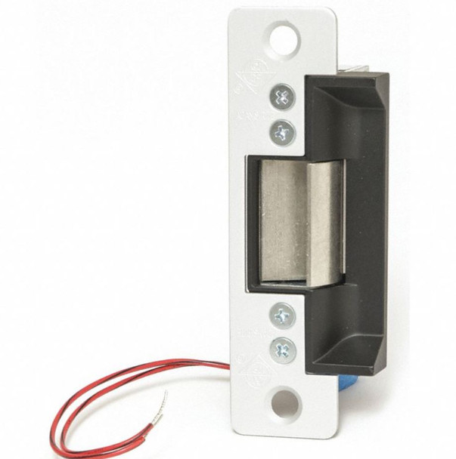
Fire Door Frames
Electric Strikes
An electric strike controls the latch bolt of the lock or panic hardware to allow or restrict access
Electric strikes for fire door assemblies must be “fail-secure” meaning the latch bolt is secure behind the strike keeper when power is cut
A fail-safe strike could allow the door to become unlatched during a fire, and is not allowed
The strike keeper should automatically be put into a secure position during a fire alarm
24

Slide 25
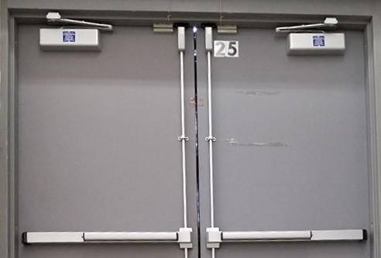
Fire Door Frames
Door Closers & Operators
Fire doors must be either be self-closing, automatic-closing, or power-operated, with two exceptions:
      The IBC exempts communicating doors between hotel rooms and fire doors installed into storm shelters (solely for compliance to ICC 500) from being self or automatic closing
      An exception in NFPA 80 allows for the inactive leaf of a pair of doors leading to rooms not normally occupied by humans to close manually, if acceptable to the Authority Having Jurisdiction (AHJ)
Self-closing doors - door closer or other closing device closes the door each time it is opened
25

Slide 26
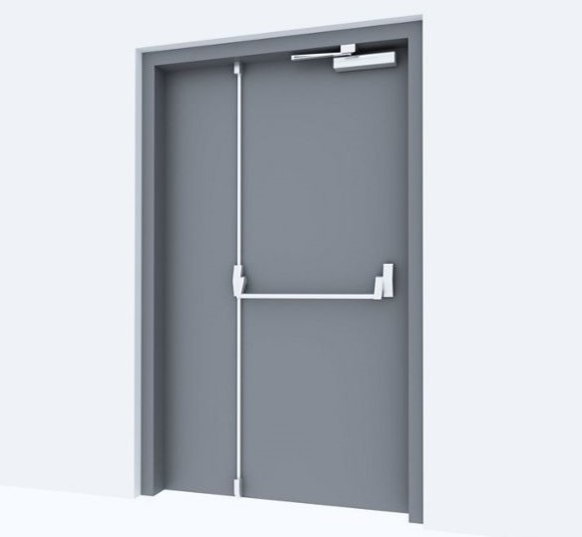
Fire Door Frames
Door Closers & Operators
Automatic Closing Doors: These doors have an electronic hold-open mechanism that releases and allows the door to close during a fire
    IBC requires hold-opens used in most fire door locations to be smoke-activated, not heat-activated
Power Operated Fire-Rated Doors: These doors have automatic operators which must be automatically disabled during a fire
26

Slide 27
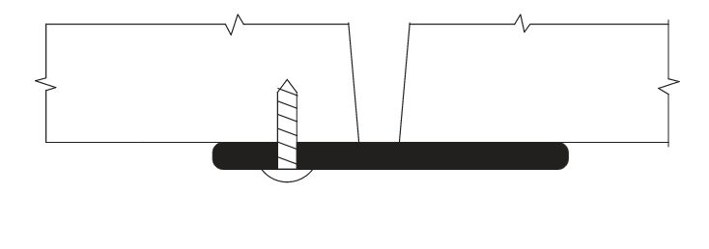
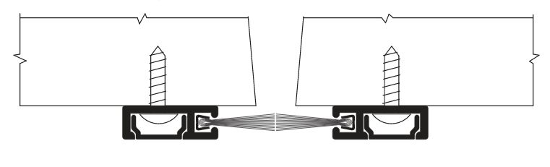
Fire Door Frames
Astragals
Astragals are components designed to seal off gaps to detain gases, smoke, or flames in the event of a fire
An overlapping astragal is not mandatory for every fire door but may be required by manufacturer’s listings
An astragal must not restrict egress and a coordinator may be required
Overlapping Astragal
Split Astragal
Meeting Stile Gasketing
27

Slide 28
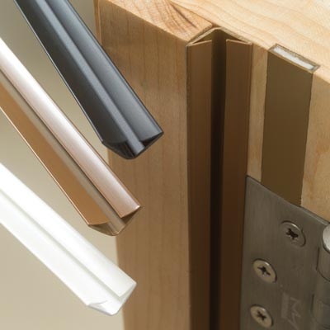
Fire Door Frames
Gasketing
Fire door gasketing is installed between a door and frame to fill gaps and prevent smoke and fire from escaping in the event of an emergency
Gasketing must be listed for use on a fire door
Smoke and draft control doors must be tested for air infiltration in accordance with UL 1784
The IBC limits the maximum air leakage rate to 3.0 ft³/min/ft² of door opening at 0.1 of water column
Bottom seals and thresholds are not required for fire doors in many locations
28

Slide 29
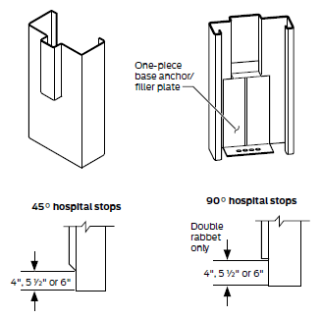
Fire Door Frames
Terminated Stops
Double Rabbet
Terminated stops are also referred to as ‘sanitary stops’ or ‘hospital stops’
They make it easier to clean the area around the bottom of a door frame where typically you might find dirt buildup
Terminated stops are not currently addressed in NFPA 80, but most manufacturers’ listings allow 6” terminated stops on fire door assemblies
Terminated stops are prohibited on certain door types, such as swing doors providing smoke protection of hoistway locations
29

Slide 30
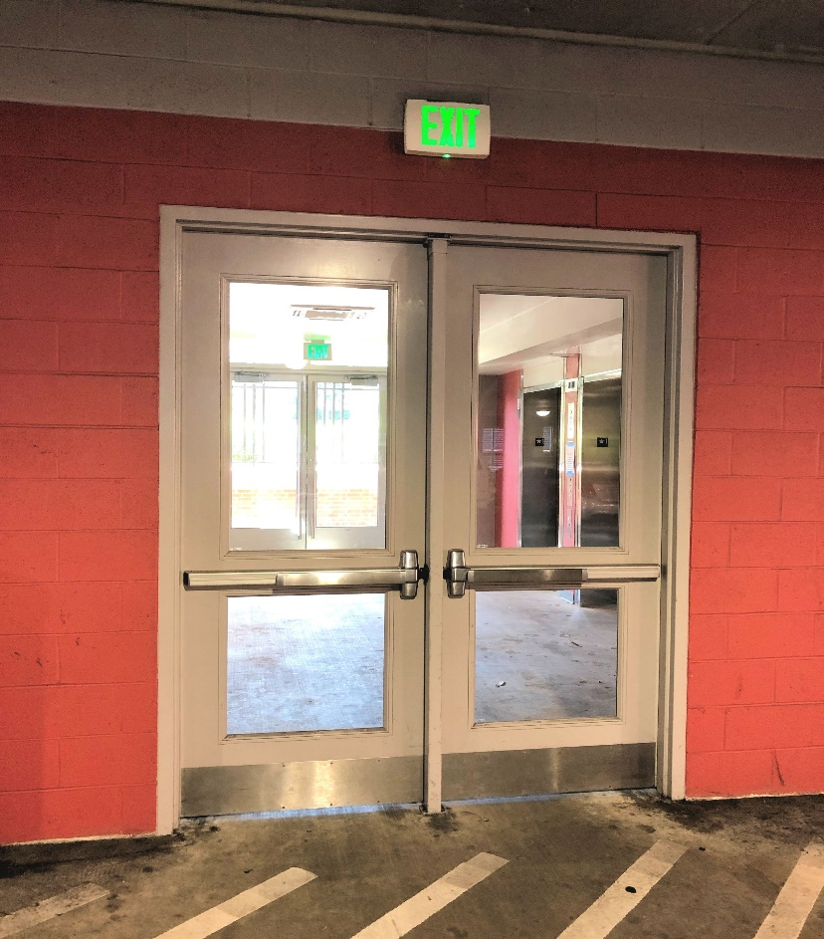
Fire Door Openings
Glazing
Glazing, or fire-rated glass panels, allow you to see through fire doors
Fire door glazing must meet the standards established by NFPA 80
Section 1-7.1 of this standard dictates that only glazing materials that are labeled as fire resistant and meet proper standards may be used
The IBC requires glazing in doors, sidelights, and other hazardous areas to be impact-resistant
30

Slide 31
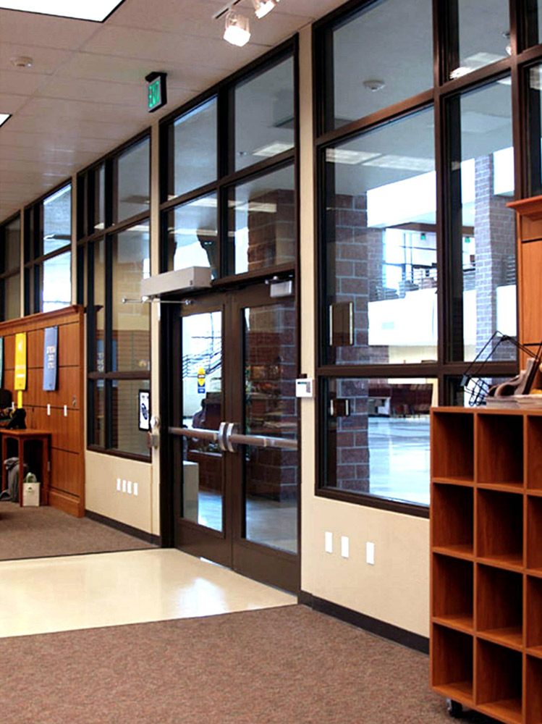
Fire Door Openings
Glazing
Many types of approved glazing are reinforced, either by chemical or manufactured means
Various types of approved glazing include materials such as:
  Ceramic glass
  Borosilicate glass
  Wire mesh reinforced glass
  Double-pane glass filled with sodium silicate
31

Slide 32
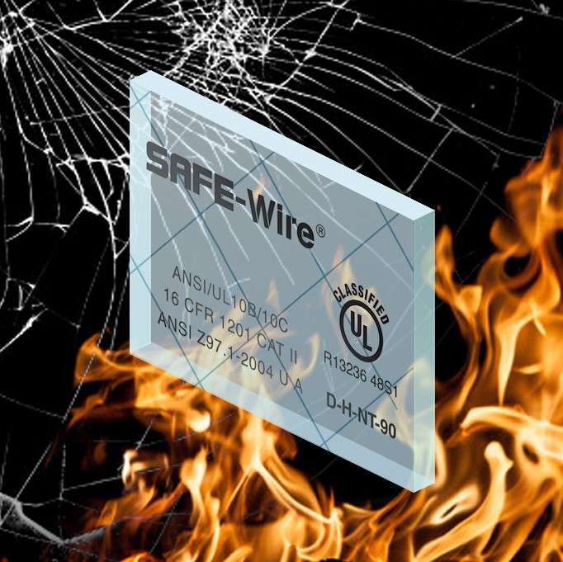
Fire Door Openings
Glazing
Glazing in fire doors was exempt from the impact requirements until the 2003 edition of the IBC
More than 2,000 accidents from non-impact-resistant traditional wired glass are reported in schools each year
Impact-resistant wired glass is available; each piece marked to indicate compliance (Note: wired glass is not acceptable / allowed in some jurisdictions)
32

Slide 33
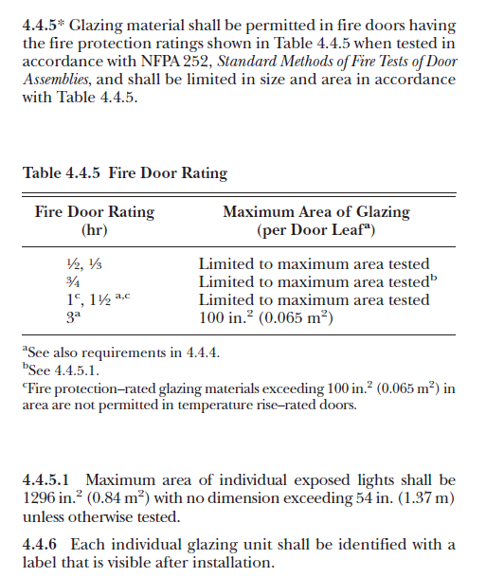
Fire Door Openings
Glazing
NFPA 80 details limitations on the size and type of glazing allowed
Glazing is limited to the maximum area tested by the door or frame manufacturer, and the glazing manufacturer
Each piece of glazing must have a visible label or etching
33

Slide 34
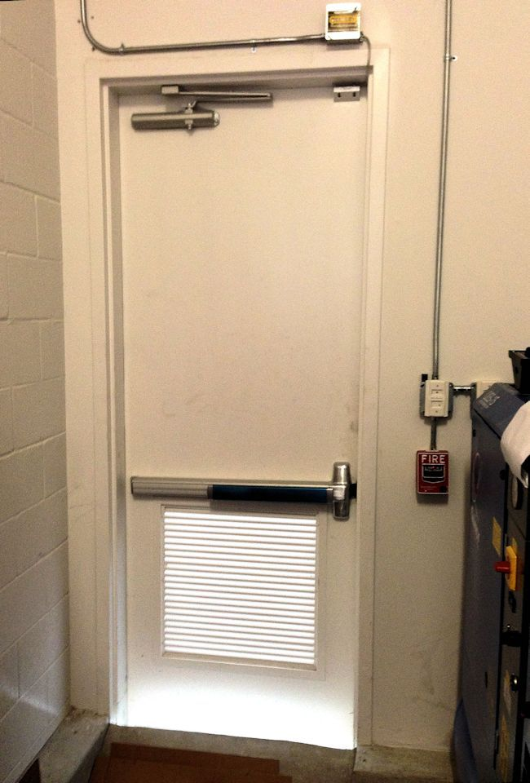
Fire Door Openings
Louvers
Fire doors designed with louvers require fusible link louvers which are automatic louvers that close upon heat activation to prevent the spread of smoke
The IBC prohibits the use of louvers in smoke barriers, smoke partitions, or corridor smoke and draft control assemblies
Louvers are prohibited for installation within transoms and side panels
34

Slide 35
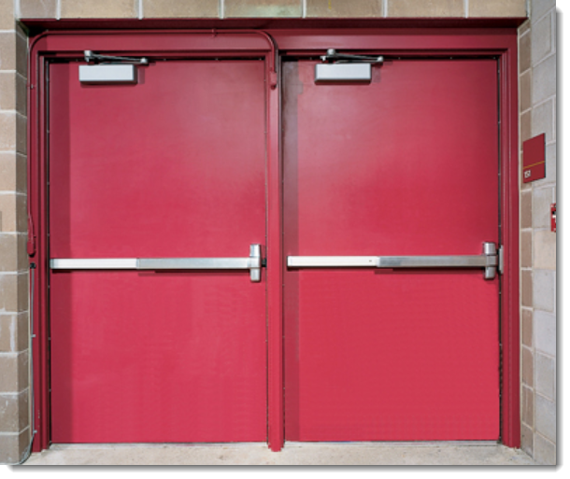
Fire Door Hardware
Function
Fire doors with builder’s hardware serve four main purposes:
    To function as a door at all times
    To provide ready egress
    To keep fire from spreading in a building
    To protect life and property
To adequately perform these functions, a fire door must be equipped with labeled hardware for dependable operation
35

Slide 36
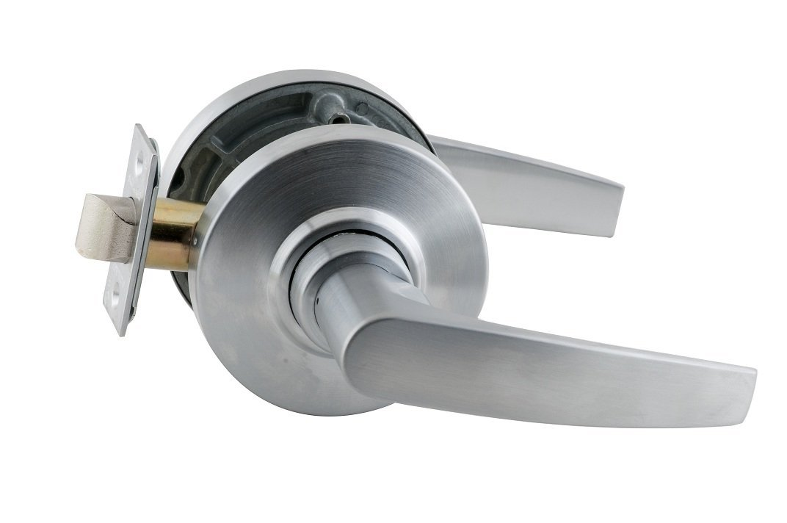
Fire Door Hardware
Locks & Latches
Fire door latches are specifically designed to withstand high temperatures and remain engaged in the extreme conditions of a fire
Positive latching is required for each fire door in order to keep the door latched and closed during a fire which protects the opening
Minimum latch throw as required by manufacturers’ listings is not specified by recent editions of NFPA 80
36

Slide 37
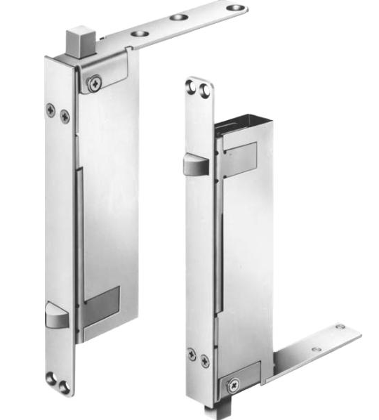
Fire Door Hardware
Flush Bolts
Automatic flush and self-latching flush bolts installed on the inactive leaf are projected by the active door leaf
Positive latching is required for all fire-rated doors regardless of the hardware that is used
    An exception in NFPA 80 allows for the inactive leaf of a pair of doors leading to rooms not normally occupied by humans to close manually, if acceptable to the AHJ
  No hardware should be installed on the inactive leaf that would indicate an operable door (examples: dummy levers or push bars)
Auxiliary fire pin may be used in lieu of a bottom bolt with some automatic flush bolts
37

Slide 38
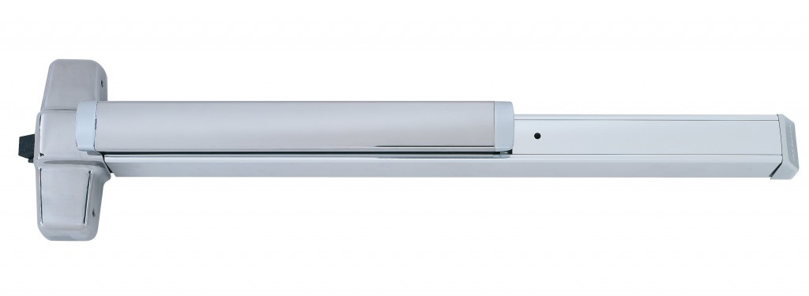
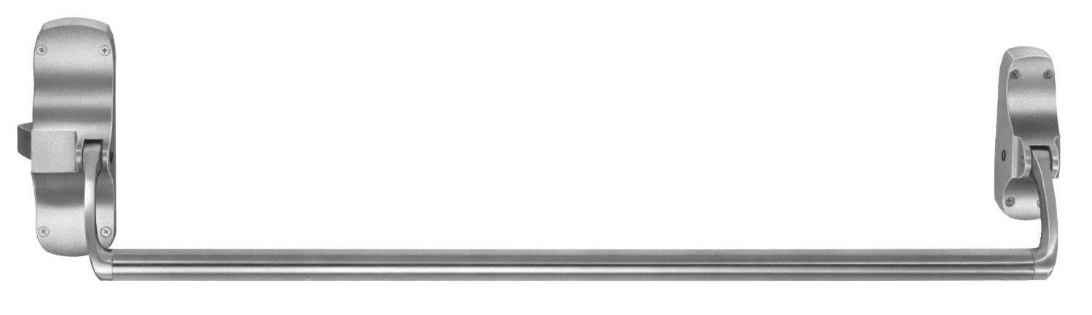
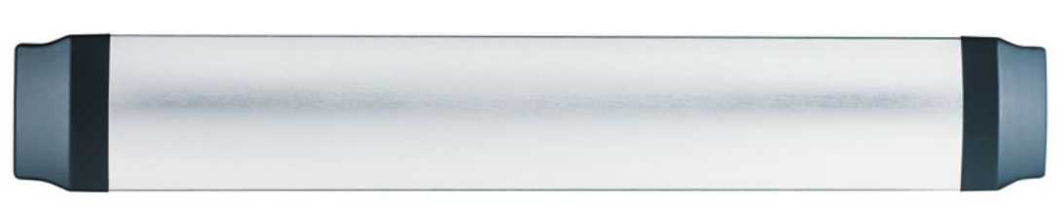
Fire Door Hardware
Panic Hardware
Touchpad Style - most common style used for modern buildings
Panic hardware is an exit device which has been tested and certified to meet the requirements of the UL 305 – Panic Hardware test standard
One requirement of UL 305 is that the hardware must unlatch when a maximum 15-pound force is applied to the touchpad or crossbar
Crossbar Style - often used for a minimal silhouette for glass doors or a vintage look
Recessed Style - requires a cut-out in the door to reduce the projection of the hardware from the door face
38

Slide 39
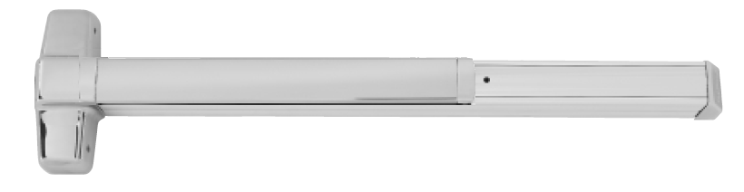
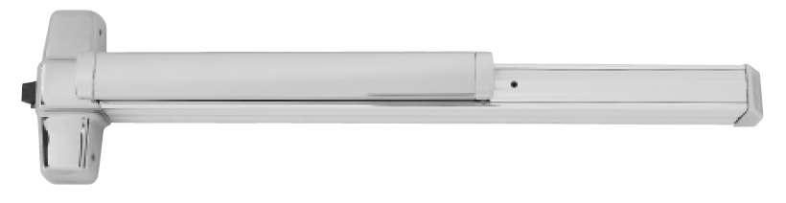
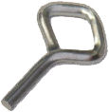
Fire Door Hardware
Panic Hardware
No mechanical dogging (holding the latch retracted with a key or tool) is allowed on fire exit hardware
Electric latch retraction exit devices and locksets may be used, provided they latch upon activation of the building’s fire alarm system
39

Slide 40
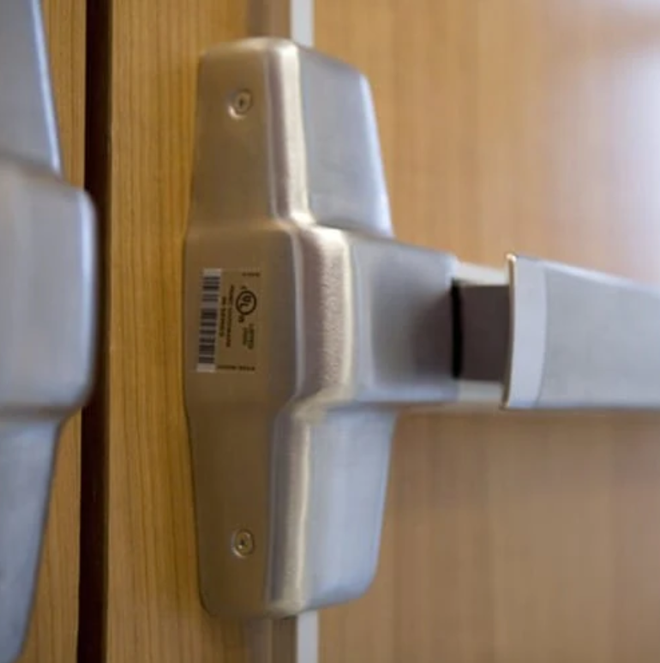
Fire Door Hardware
Labeling
Fire exit hardware devices may be used on labeled doors provided the door labeling states “Fire Door To Be Equipped With Fire Exit Hardware”
Fire exit hardware used on labeled doors must pass a panic loading test in accordance with UL 305 and a cycling test in accordance with ANSI/BHMA A156.3 in addition to the standard fire test
40

Slide 41
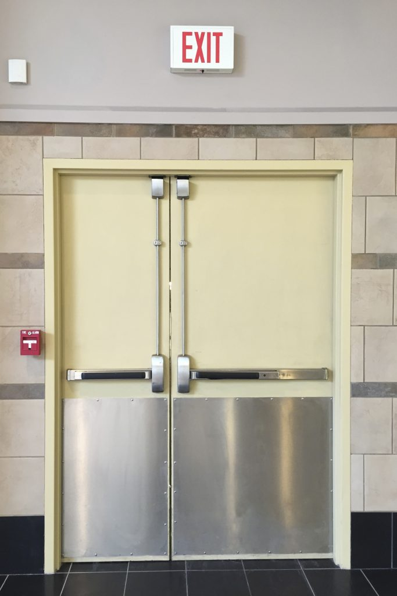
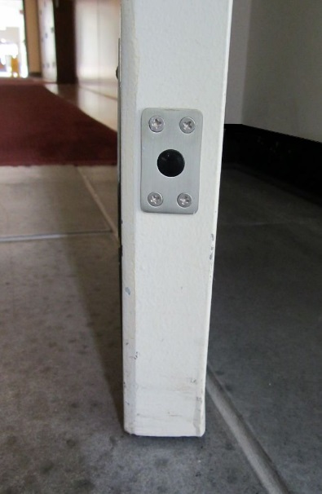
Fire Door Hardware
Rods & Latches
Fire exit hardware with vertical rods for pairs of doors is available with top and bottom rods and latches
Doors with the top rod and latch only is known as Less Bottom Rod or LBR
Less Bottom Latch (LBL) doors have no bottom rod, latch, or strike
An auxiliary fire pin typically required for LBR/LBL applications - mounted on the door edge, it is retracted until released during a fire
Auxiliary Fire Pin
LBR Fire Door
41

Slide 42
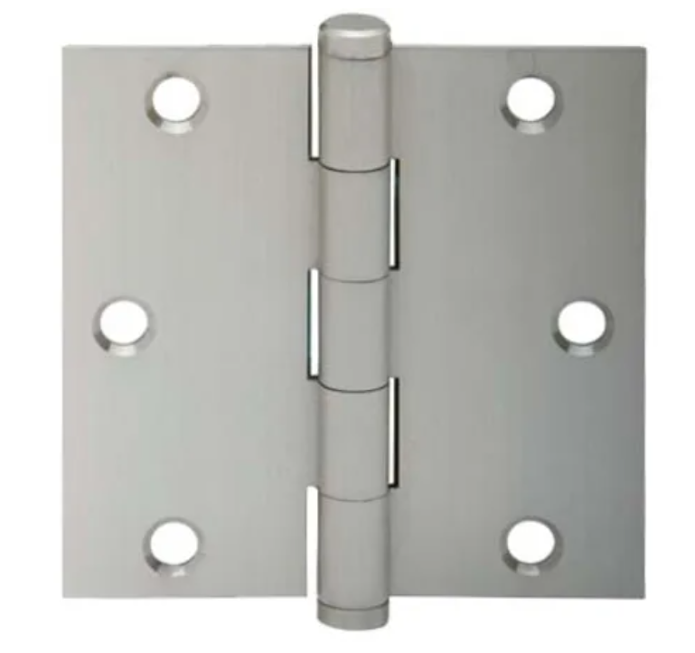
Fire Door Hardware
Hinges
Fire door hinges must be a steel base material, ball bearing type, or listed for use on a fire door
  2 hinges for the first 60” of door height, 1 additional hinge for each additional 30” of door height, or portion thereof
Spring hinges - doors maximum of 3 feet wide and 7 feet high, or as tested
NFPA 80 states the length of continuous hinges must be within 1” of the door height
42

Slide 43
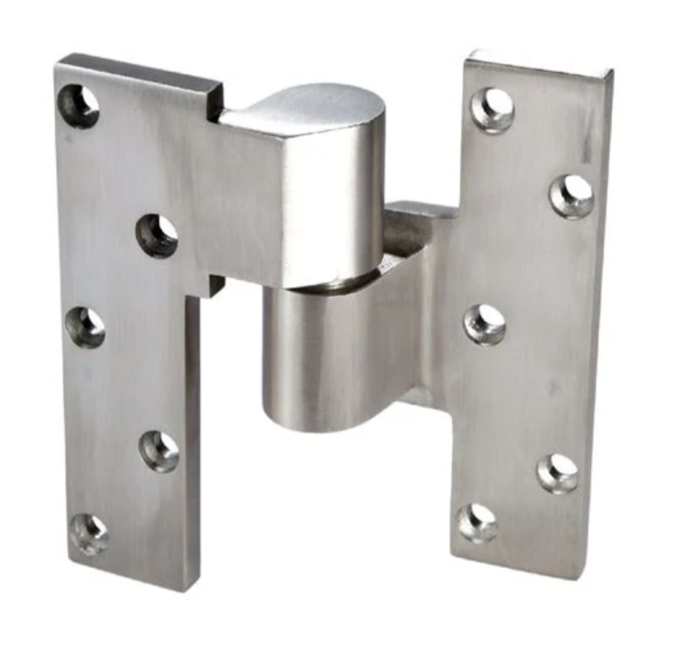
Fire Door Hardware
Pivots
With top and bottom pivots:
    1 intermediate pivot for doors up to 90” in height
    For doors over 90” in height, 1 additional intermediate pivot for each 30” of door height or fraction thereof
With only intermediate pivots - no top and bottom pivot set:
      2 intermediate pivots for door leaves up to 60” in height
      1 additional intermediate pivot for each 30” of door height or fraction thereof
43

Slide 44
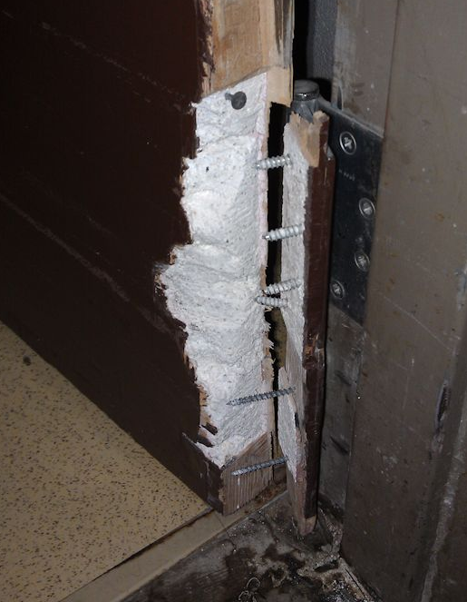
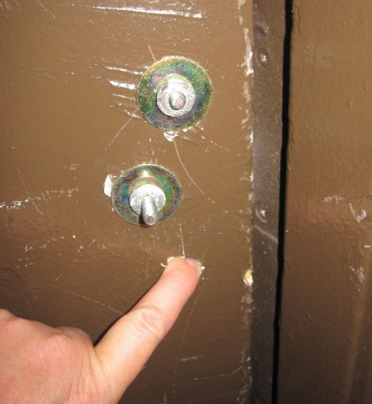
Fire Door Hardware
Fasteners
Install hardware with fasteners is supplied by the manufacturer, unless alternative fasteners are allowed
Thru-bolts may be required unless doors have special internal reinforcement or blocking
There are specific requirements for fasteners for some products detailed in NFPA 80
44

Slide 45
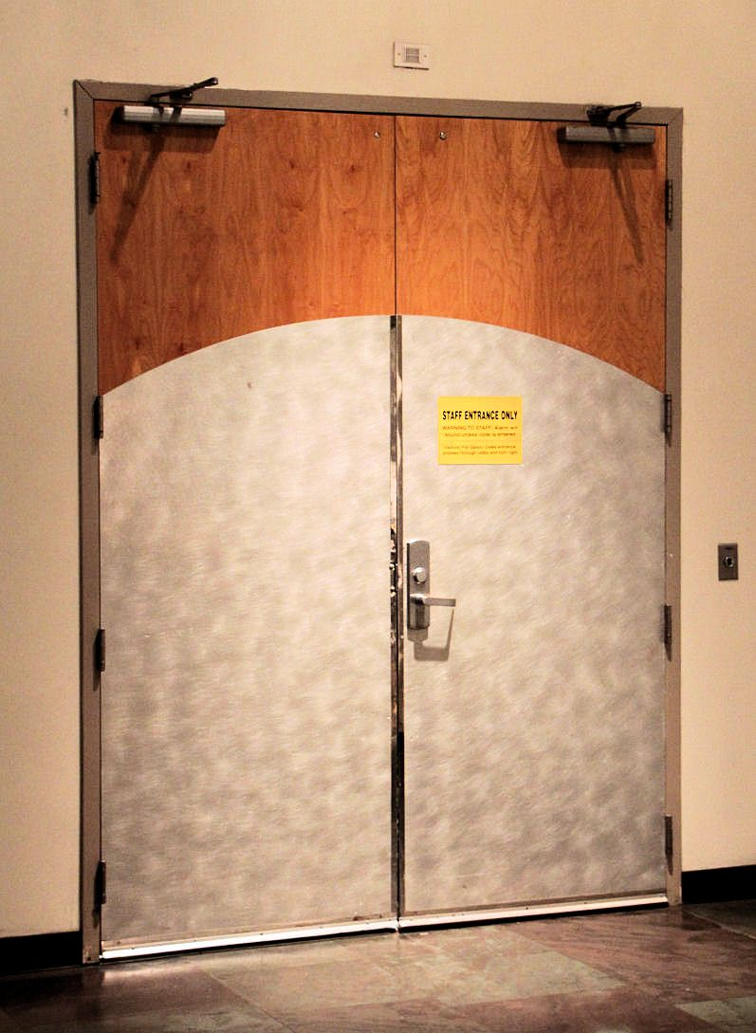
Fire Door Hardware
Protection Plates
NFPA 80 limits the height of protection plates on fire doors:
  Bottom 16 inches of the door may be field-installed, no label required on plate
  Installed under label service (at the factory or in an approved shop) as allowed by the manufacturer’s listings
  Field-installed plates mounted above the bottom 16 inches of the door and must be labeled
45

Slide 46
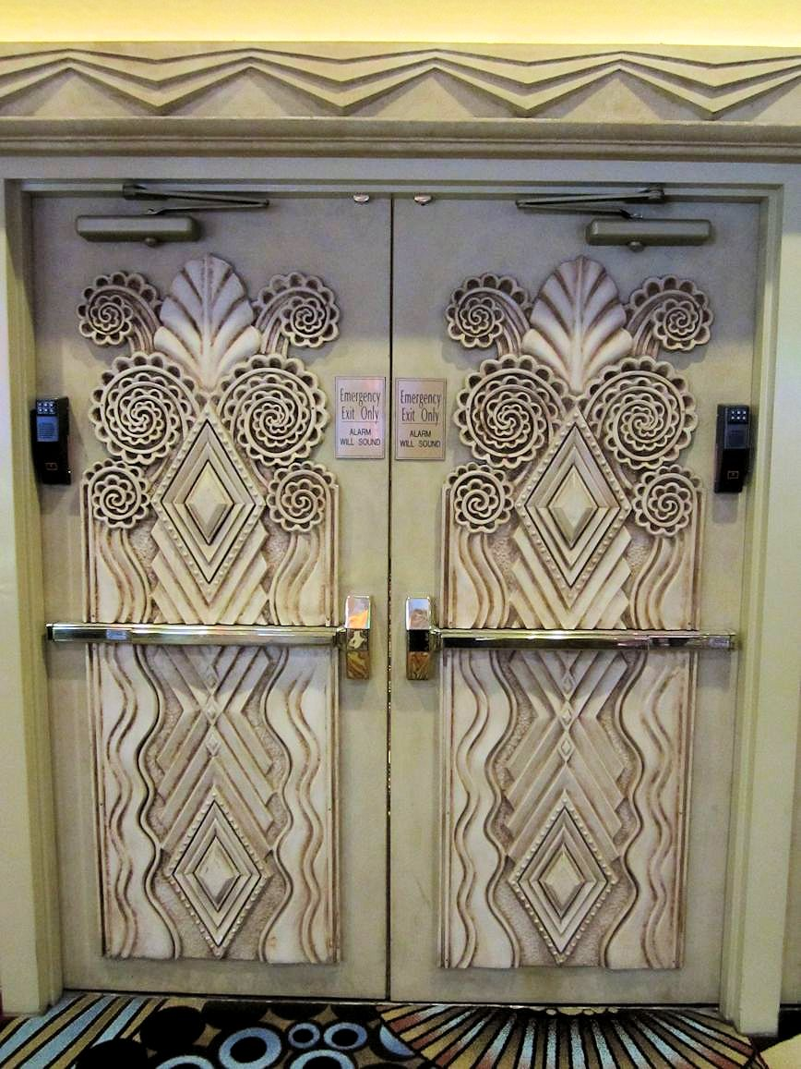
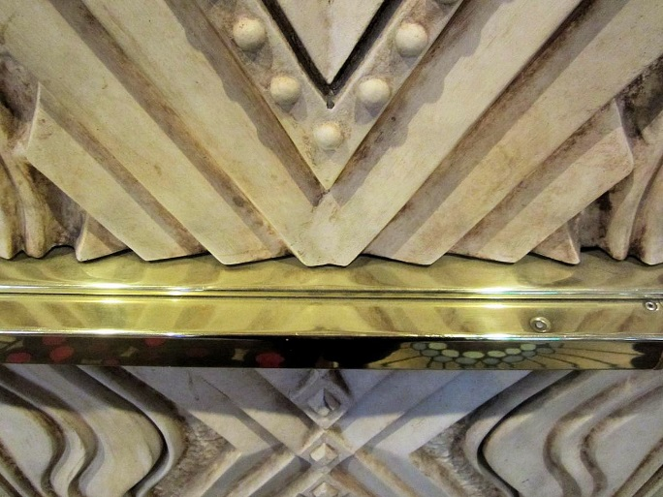
Fire Door Hardware
Plant-Ons
A plant-on is a decorative trim applied to the face of a door
Consult the door manufacturer to verify listing requirements before installing plant-ons on fire-rated doors
46

Slide 47
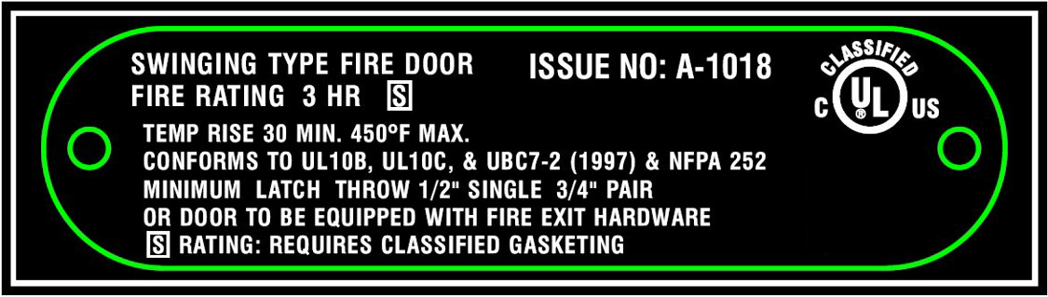
Fire Door Requirements
Labels
Fire-rated door labels are required by NFPA 80 to indicate that a fire door and frame have been tested and passed to required standards
They are usually attached to the hinge side of both the door panel and frame and should remain legible throughout the door's life
They must include detailed information such as the rating, test methods, required latch throw, smoke resistance, and an issue number which can be used for further information
47

Slide 48

Fire Door Assembly Requirements
SDI 118 – 21
SDI 118-21, a publication of the Steel Door Institute, covers basic fire door assembly requirements for:
  Fire doors
  Fire door frames
  Transom/sidelight frames
  Window frames
48

Slide 49

Fire Door Assembly Requirements
SDI 118 – 21
The fire-protection classification of the wall into which the door is installed dictates the required fire-protection rating of the door
A graphical representation of the NFPA 80 opening protective requirements is also included in Table 1
49

Slide 50

Fire Door Installation
Clearances & Undercuts
Clearance limited by NFPA 80:
  Bottom of Door: 3/4” maximum, 3/8” maximum if bottom of door is more than 38” above the floor (ie. counter shutter, chute door)
  Hollow Metal Door: head, jambs, and meeting stiles - 1/8” +/- 1/16”
  Wood Door: head, jambs, and meeting stiles -wood doors 1/8” max
50

Slide 51

Fire Door Installation
Clearances & Undercuts
Doors with non-compliant clearances can not be repaired by adding standard gasketing products
Product must be specifically listed for use on a door with oversized clearances
Note limitations on fire rating, door material, and clearance dimension
51

Slide 52

Fire Door Installation
Job-Site Preparations / Field Modifications
Job-site preparations:
  Holes for hardware up to 1” in diameter
  Cylinder holes may be of any size and are permitted for surface-applied hardware installed in accordance with the manufacturer’s listing
  Maximum ¾” undercutting if acceptable to the door manufacturer
52

Slide 53

Fire Door Installation
Job-Site Preparations / Field Modifications
Field modifications beyond the allowable job-site modifications require advance approval from the listing agency
The fire door assembly may need to be relabeled in the field if other alterations are made
53

Slide 54

Fire Door Installation
Job-Site Preparations / Field Modifications
When material is removed from a fire door or frame, the holes must be:
  filled with steel fasteners
  filled with the same material as the door or frame
  or
  filled with a material approved for that use
This is intended to apply to fastener holes
Consult the door or frame manufacturer for holes that are not fastener holes
54

Slide 55


Fire Protection vs. Fire Resistance
Applicable Standards
Fire protection in a door is about containing fire, smoke, and some heat for a set period of time
  For standards on Fire Protection Rated Assemblies refer to UL 10C or NFPA 252
Fire resistance in a door is similar, but it also protects the door's structural integrity and blocks radiant and conductive heat
  For standards on Fire Resistance Rated Assemblies refer to UL 263 or ASTM E119
55

Slide 56
Fire Protection vs. Fire Resistance
IBC Table 716.1(2)
Fire-protection-rated transom and sidelight frames are not permitted in some locations
These locations require fire-resistance-rated frames, with a rating equal to the rating of the wall
56

Slide 57

Fire Protection vs. Fire Resistance
IBC Table 716.1(2)
Permits fire-protection-rated assemblies in some locations
57

Slide 58

Fire Protection vs. Fire Resistance
IBC Table 707.6
Limits openings in a fire barrier, but this limit does not apply to assemblies tested to ASTM E119 or UL 263
58

Slide 59

Fire Prevention
Do’s and Don’ts for Fire Doors
Don’t Block or Prop Open
    Fire doors should be easily openable from the inside during an emergency
    Propping open a fire door can allow smoke and other combustion products to spread the fire
Don’t Modify
    Modifying a fire door, such as drilling into it, can void its fire rating and make it unsafe
    Avoid painting the fire labels on the door frame or smoke seals, or sticking materials to the door or frame
59

Slide 60

Fire Prevention
Do’s and Don’ts for Fire Doors
Don’t Install Certain Hardware
    Kick plates taller than 16 inches from the bottom of the door can reduce the door's fire resistance
    Do not use wooden, plastic, or nylon shims on the hinges, as only steel shims can be used on fire-rated doors per NFPA 80
Don’t Store Equipment or Items Against the Door
      Avoid storing equipment or combustibles against the door that can block access
60

Slide 61

Fire Prevention
Do’s and Don’ts for Fire Doors
Don’t Damage Labels
      Do not remove, conceal, or damage fire labels on the door, frame, or hardware
Do Inspect, Maintain & Test
    NFPA 80 requires that fire doors are inspected, maintained, and tested annually
    Commercial fire-rated doors should also be drop-tested annually to ensure they close quickly and accurately
61

Slide 62


This closed fire door protected the Robert Moses Nature Center during a fire that started in the workshop
Fire Prevention
Case Study
Photos courtesy of:
Christopher Taylor, NYS Office of Fire Prevention & Control
62

Slide 63


Fire Prevention
Case Study
Photos courtesy of:
Christopher Taylor, NYS Office of Fire Prevention & Control
63

Slide 64


Fire Door Testing
Positive Pressure Test
Positive pressure fire testing more accurately represents the conditions of an actual structure fire, and will provide a relative measure of performance of door assemblies under these specified exposure conditions
UL 10C and NFPA 252 both describe the positive pressure test method, which dictates establishing the neutral pressure plane at 40 inches above the door sill no later than 5 minutes of the start of the test
Photos courtesy of:
Leslie Miller, Fire Protection Publications
64

Slide 65

Fire Door Testing
Fire Endurance Test
The fire endurance test is controlled in accordance with the Standard Time-Temperature Curve
Temperature measured with not less than nine thermocouples symmetrically distributed to show the temperature near all parts of the test assembly​
Curve is based upon combustion of cellulose materials
Temperature reaches 1,000°F within first five minutes and then gradually increases thereafter
Standard Time-Temperature Curve
65

Slide 66


Fire Door Testing
Hose Stream Test
The hose stream test occurs after the fire test
Per NFPA 252: “The application of water produces stresses in the assembly and provides a measure of it’s structural capability”
It is not typically required for 20-minute fire doors in the US
The hose stream test does not measure thermal stress performance of glazing materials
Photos courtesy of:
Leslie Miller, Fire Protection Publications
66

Slide 67

Fire Door Assembly Inspection Checklist
Labels Are Present & Legible
  If a label is missing from a component of a fire door assembly, the component may need to be field labeled by an authorized labeling service
67

Slide 68

Fire Door Assembly Inspection Checklist
No Holes Or Breaks In The Door Or Frame
  NFPA 80 addresses the acceptable means for filling fastener holes; other holes must be treated as a field modification as outlined in the standard
68

Slide 69

Fire Door Assembly Inspection Checklist
Glazing & Glass Kit Are Intact & Securely Fastened
  Recent editions of the codes and standards require glazing in fire door assemblies to be labeled with information referencing applicable standards for impact resistance and fire testing
69

Slide 70

Fire Door Assembly Inspection Checklist
Door, Frame & Hardware Are In Proper Working Order
  Assemblies must be visually inspected from both sides, and acceptance testing includes closing the door by all means of activation
70

Slide 71

Fire Door Assembly Inspection Checklist
No Missing Or Broken Parts
  If deficiencies are noted, they must be repaired/replaced “without delay”
  Some AHJs require deficiencies to be addressed within 60 days
71

Slide 72

Fire Door Assembly Inspection Checklist
Door Clearances Are Within Allowable Limits
  The limitations of NFPA 80 apply to the installed condition of the assembly
  Manufacturing tolerances are not intended to be added to the maximum allowable clearance
72

Slide 73

Fire Door Assembly Inspection Checklist
Door Closer/Hinges Are Operational & Door Is Self-Closing
  Fire doors must be self-latching and may also be automatic-closing or power-operated, in accordance with the standard
73

Slide 74
Fire Door Assembly Inspection Checklist
Coordinator Ensures Door Leaves Close In Proper Sequence
  This requirement applies only to pairs of doors where one leaf must close before the other
Bar-type coordinator mounts on
the underside of the frame head
Gravity coordinator
mounts on the face of the frame head
74

Slide 75
Fire Door Assembly Inspection Checklist
Door Is Self-Latching In Closed Position
  This helps to ensure that the door will remain closed during a fire, to deter the spread of smoke, flames, and toxic gases
75

Slide 76

Fire Door Assembly Inspection Checklist
Opening Not Equipped With Auxiliary Hardware Interfering With Operation
  An example of an unacceptable item would be auxiliary hardware which could prevent the door from properly opening and closing
76

Slide 77

Fire Door Assembly Inspection Checklist
No Field Modifications That Void The Label
  NFPA 80 details allowable job-site preparations, and field modifications may be approved by the listing agency
77

Slide 78

Fire Door Assembly Inspection Checklist
Required Gasketing & Edge Seals Are Present, Continuous & Proper Type
  Note that gasketing is typically required for fire doors in corridors and smoke barriers but is not required for every fire door assembly
78

Slide 79

Fire Door Assembly Inspection Checklist
Signage Covers Less Than 5% Of Door Face
  NFPA 80 requires signage installed with adhesive or with up to four steel or stainless-steel sheet metal screws up to US size #8 or up to 0.17” diameter, only permitted to penetrate one side of the door
  Signs must not be installed on glazing and must not interfere with the operation of the door
79

Slide 80

Fire Door Assemblies
Specification Tips
Be aware of the NFPA 80 requirements
Verify manufacturers can provide the specified products
Construction labels must be approved by the AHJ
For modifications of existing fire doors, alterations should be approved in advance by the listing agency, or the doors and frames may have to be relabeled in the field
80

Slide 81

Fire Door Assemblies
Specification Tips
Specifications should clearly state whether openings are to be:
  Fire-protection-rated per UL 10C or NFPA 252
  or
  Fire-resistance-rated per ASTM E119 or UL 263
The post-installation fire door assembly inspection is an important benefit for the owner, and should be included in the specification
81

Slide 82




Additional Resources
Steel Door Institute (SDI)
steeldoor.org
International Code Council (ICC) ICCSAFE.org
Intertek Testing Service (ITS)
Intertek.com
National Fire Protection
Association (NFPA)
NFPA.org
Underwriters
Laboratories (UL)
UL.com
82

